Slide 1
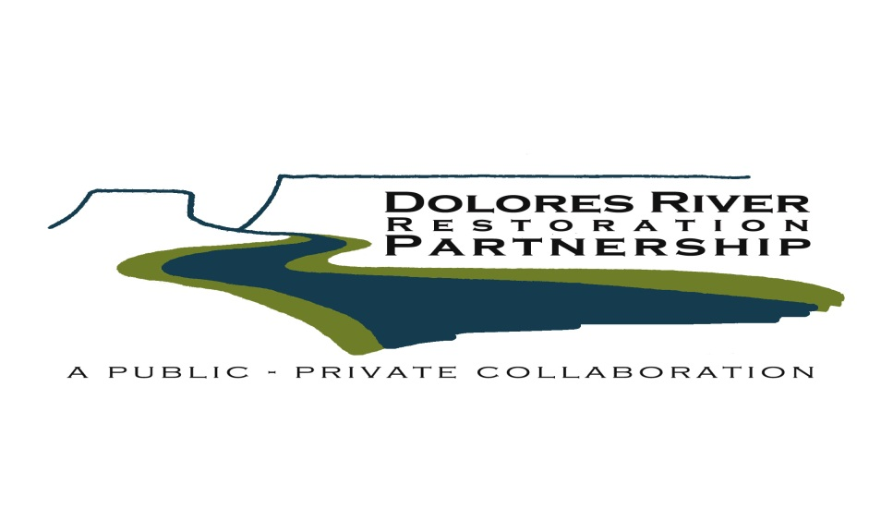
DRRP—Grand Junction
Fall 2014: Where we’re at, and where we’re headed
Sparky Taber-GJFO BLM

Slide 2
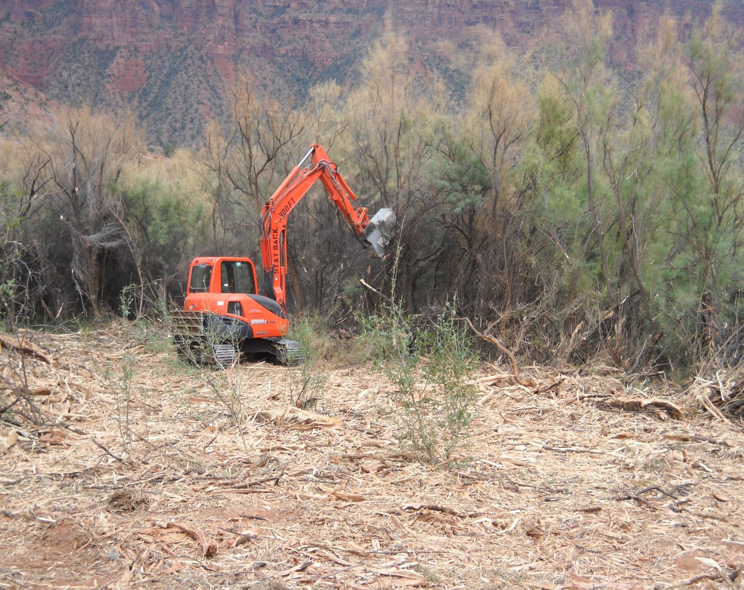
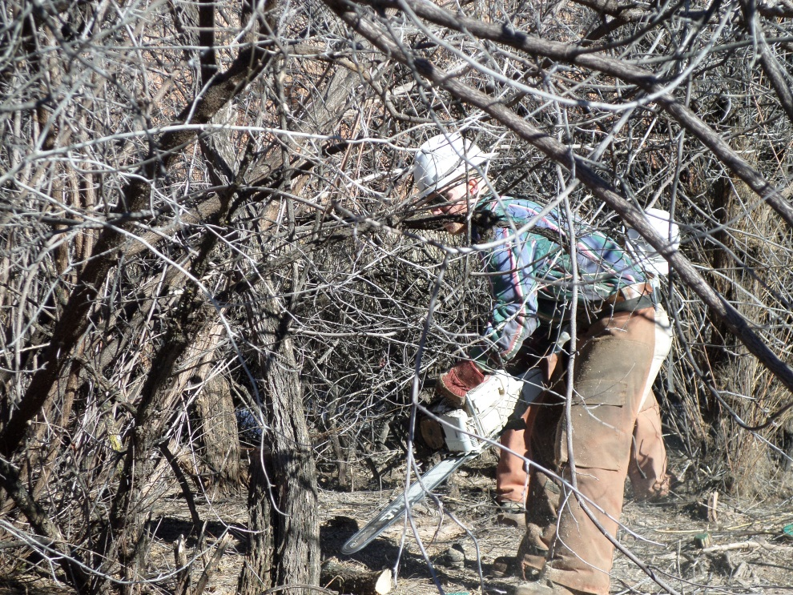
To Date:
94 distinct active treatment units for 717 acres
Smallest: .1 acres
Largest: 96 acres
Avg. size: 7.6 acres
Mechanical, manual, secondary weed treatments, re-vegetation

Slide 3
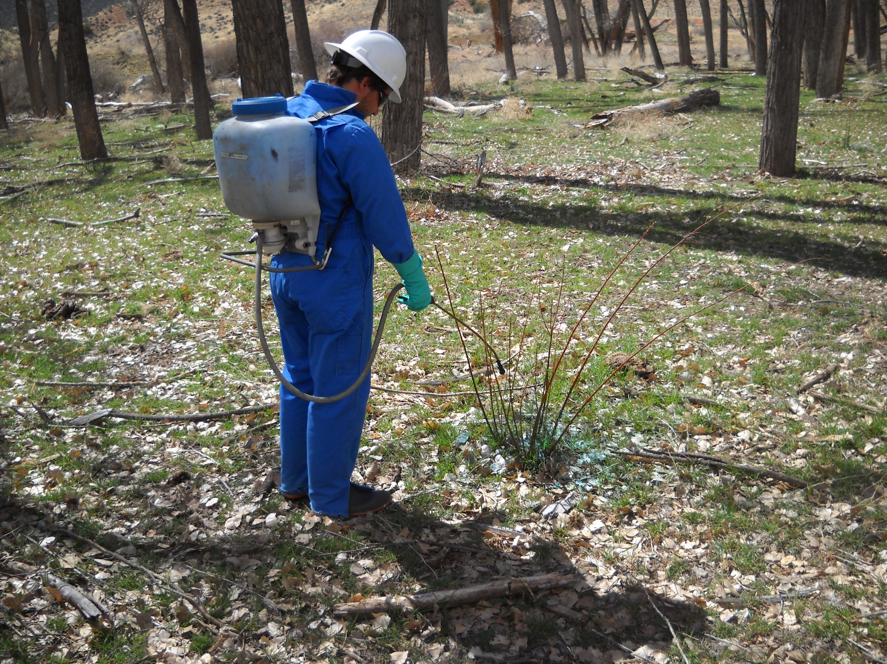
Resprouts:
Most units (except those in progress) have been treated at least once, some as many as 3X.

Slide 4
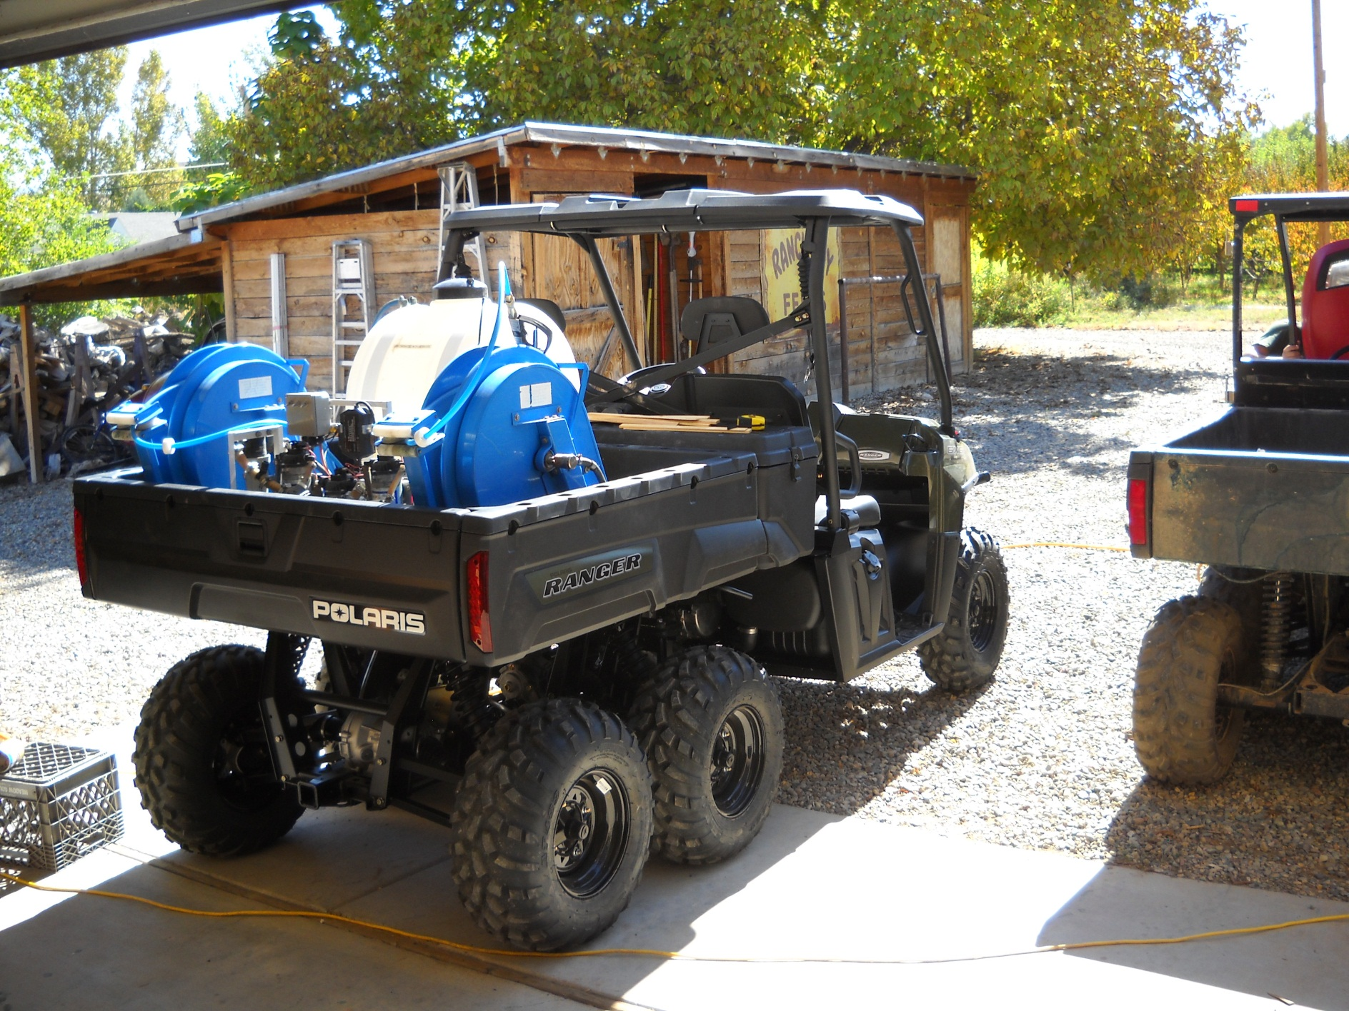
Knapweed:
19 miles of river have been treated on both sides. More to come after in-progress tamarisk work done.

Slide 5
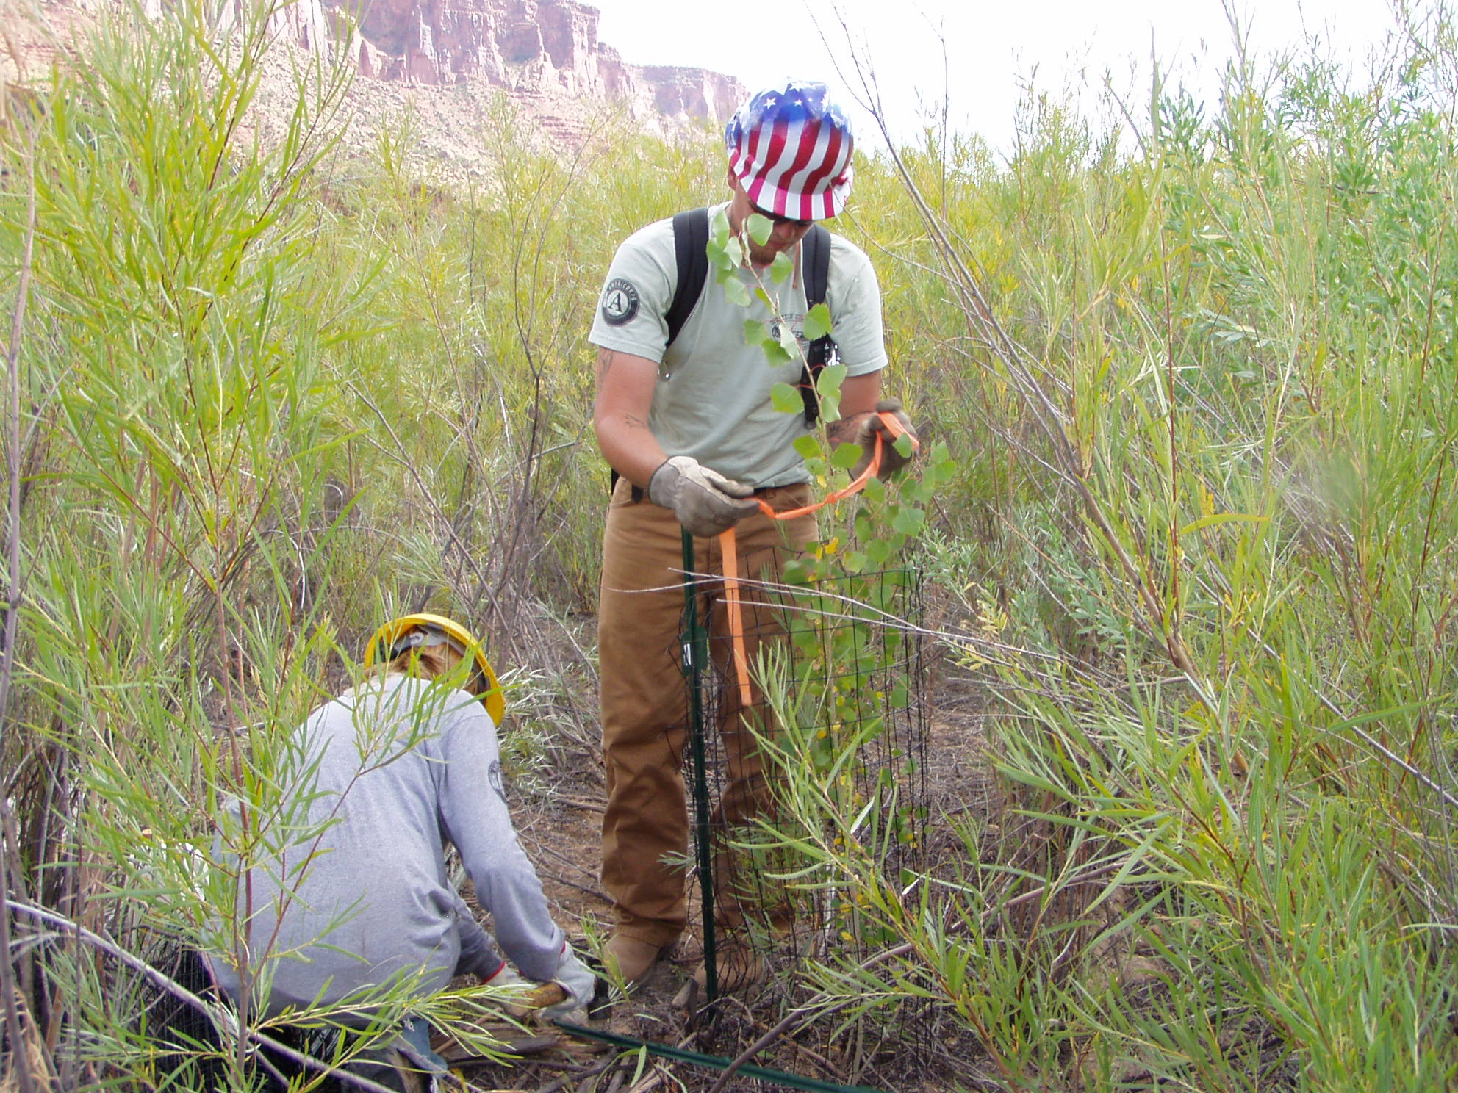
Cottonwoods:
Hundreds of natural-start trees have been wrapped

Slide 6
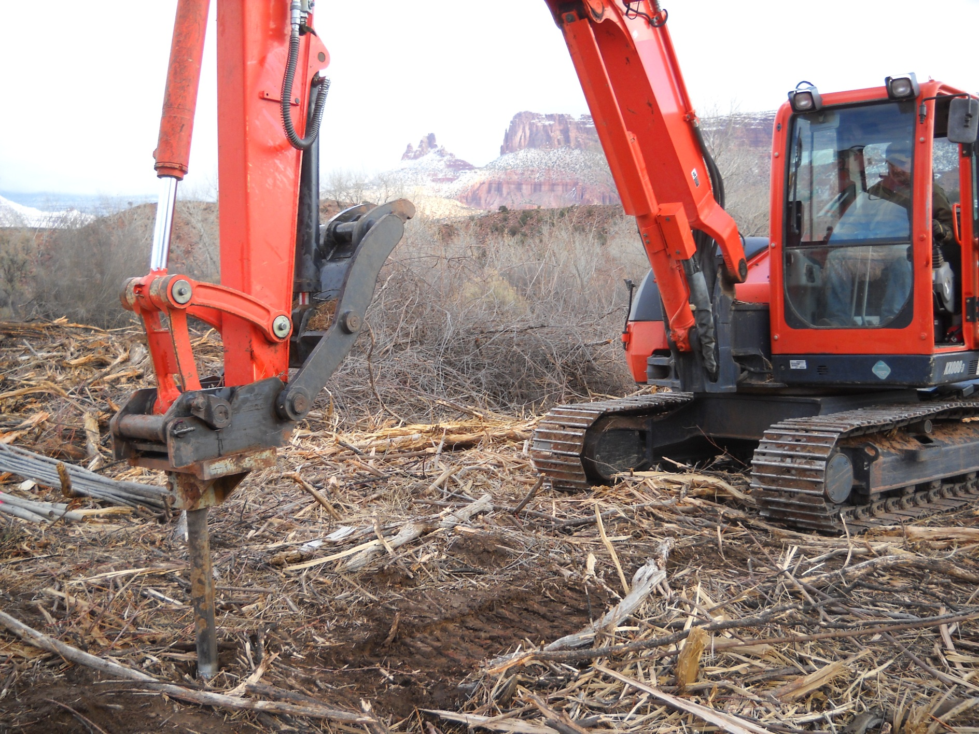
Cottonwoods:
Some were added mechanically

Slide 7
Fish Sampling……..

Slide 8
Fish sampling……..

Slide 9
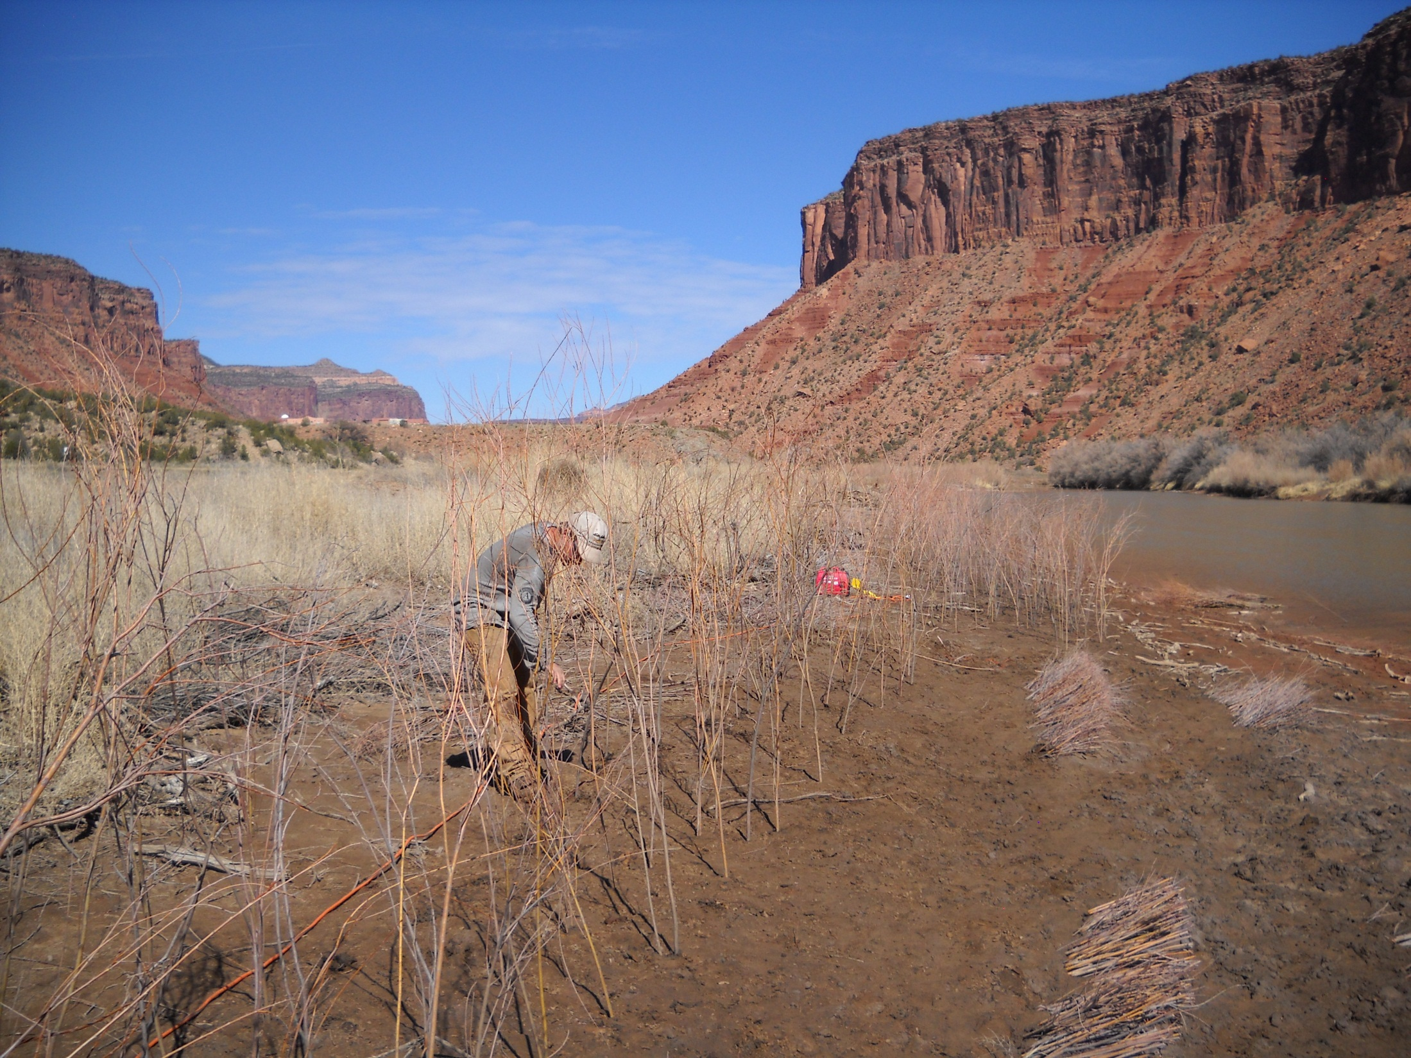
Willows and seed:
Thousands of willows planted over many sites
Numerous units seeded with grasses and shrubs

Slide 10
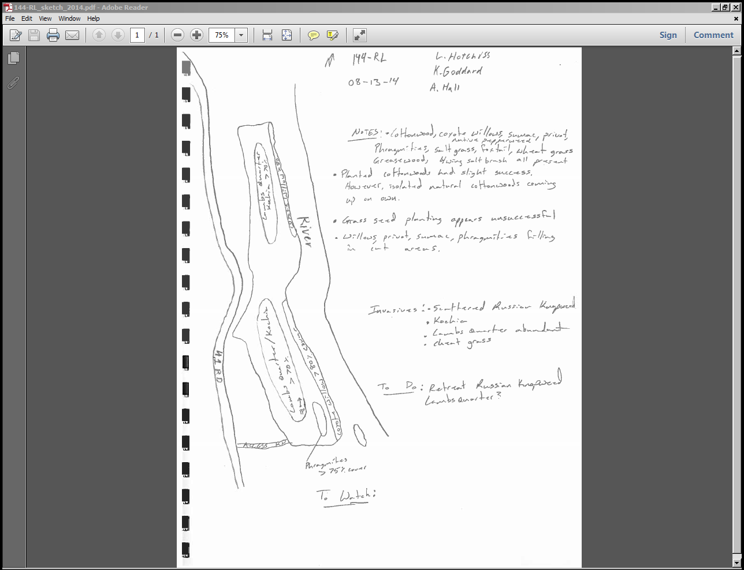
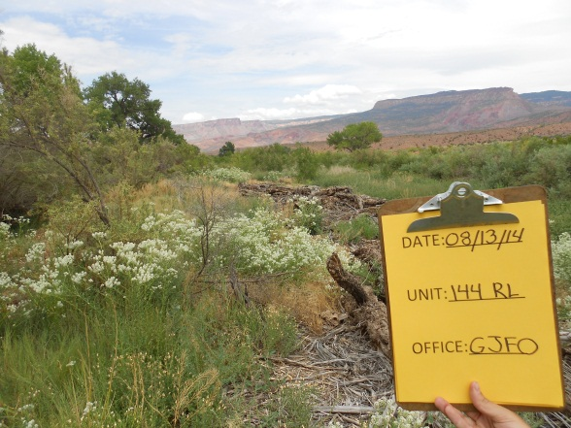
Monitoring:
Crew is nearing completion of a thorough evaluation of all 94 units.
Data will inform us of future maintenance work.

Slide 11
Where we are headed……..
You go first. It’s full of bears.
Let’s go here…

Slide 12
Finishing touches (on the 94 units):
Complete resprout treatments (winter 2014/2015)
Complete monitoring (fall 2014)
Complete tamarisk removal (winter 2014/2015)
Complete initial knapweed treatments (fall 2014)

Slide 13
Future maintenance work…………

Slide 14
Hoary cress (whitetop)treatments ID’d in monitoring (spring season)

Slide 15
Kochia & lambsquarters suppression (spring season)
Kochia

Slide 16
Cheatgrass suppression in select areas (fall season)

Slide 17
Knapweed re-treatments (fall season)
Residual knapweed

Slide 18
Burn piles….(winter)

Slide 19
Unwrap cottonwoods….(anytime)

Slide 20
Re-work sites with over-thick mulch (fall/winter)
Expose more soil
Re-seed if necessary
Options:
Contract skid steer or small dozer
Agency skid steer
Agency Fecon® mulcher
Contract Fecon® mulcher

Slide 21
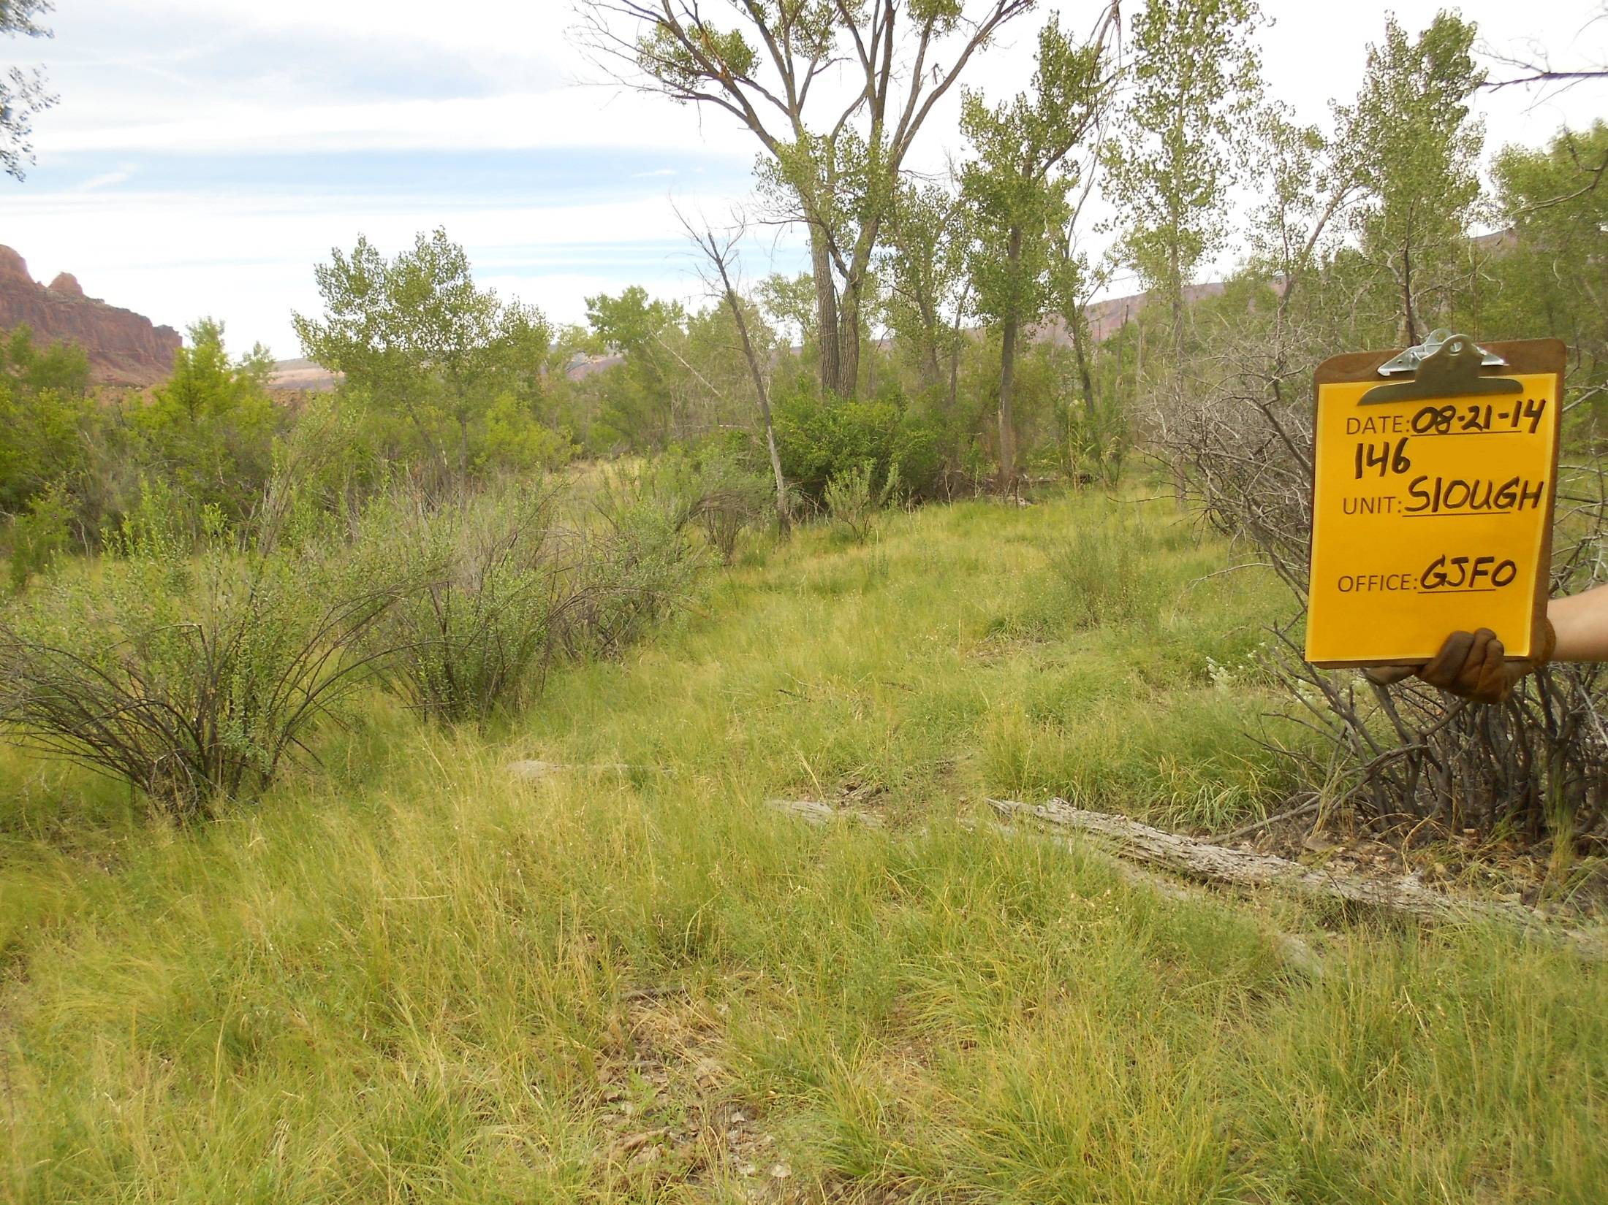
Questions?
Comments?

